Slide 1
Project 0
Rachel Weber

Slide 2
The Data
130 people randomized to 1 of 5 possible treatments
Gum health was measured 2 ways:
Pocket depth
Attachment loss
Patients were measured at baseline and 1 year later
Demographic variables including age, race, and smoking status were recorded
Question of Interest: Does some level of medication in a topical gel improve gum health when applied twice daily for one year?

Slide 3
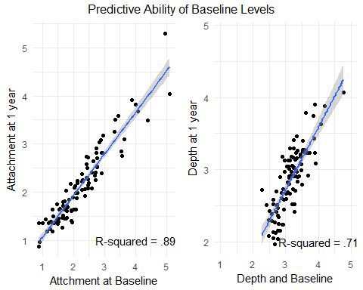
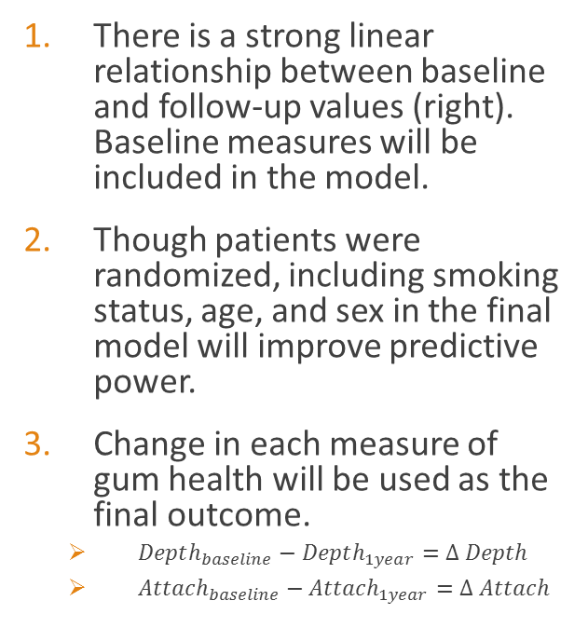
Important Notes
There is a strong linear relationship between baseline and follow-up values (right). Baseline measures will be included in the model.
Though patients were randomized, including smoking status, age, and sex in the final model will improve predictive power.
Change in each measure of gum health will be used as the final outcome.
$Depth_{baseline}−Depth_{1year}=Δ Depth$
$Attach_{baseline}−Attach_{1year}=Δ Attach$

Slide 4
The Analysis
Placebo vs. Control
A T-test comparing change in both outcomes between Placebo and Control patients indicated no significant difference (p-values: .08 attachment, .88 depth)
Conclusion: there was no effect of the gel alone in improvement of a patient’s gum tissue over that seen in controls
Attachment
After adjustment for demographic variables, an F-test indicated that there was no significant treatment effect of medicated gels on patient attachment loss (p-value: .1166)
Conclusion: No level of medicated gel improved attachment loss after 1 year
Depth
After adjustment for demographic variables, an F-test indicated that there was no significant treatment effect of medicated gels on patient pocket depth (p-value: .1116)
Conclusion: No level of medicated gel improved pocket depth after 1 year

Slide 5
Takeaways
Attachment loss and pocket depth were not impacted by medication levels in topical gel.
There is no improvement in gum health with the application of placebo gel over that seen in control patients.
10 patients assigned to treatment group 5 did not complete treatment. There may be a negative effect of high levels of medication that aren’t documented in the data.

